Slide 1
Storytelling Case Study: Airbnb, NY
Biplab Mondal

Slide 2
Objective:
Airbnb is an online platform using which people can rent their unused accommodations.
Airbnb incurred a huge loss in revenue during the covid time.
Airbnb is aiming to bring up the business again and is ready to provide services to customers as people have now started travelling again.

Slide 3
Background
Airbnb has seen a major decline in revenue for the past few months.
Airbnb wants to make sure that it is fully prepared for this change as now the restrictions have started lifting and people have started to travel more.
So, analysis has been done on a dataset consisting of various Airbnb listings in New York.

Slide 4
Data Preparation
To remove any missing values and duplicates data has been cleaned.
Insignificant columns have been dropped.
Outliers have been identified.

Slide 5
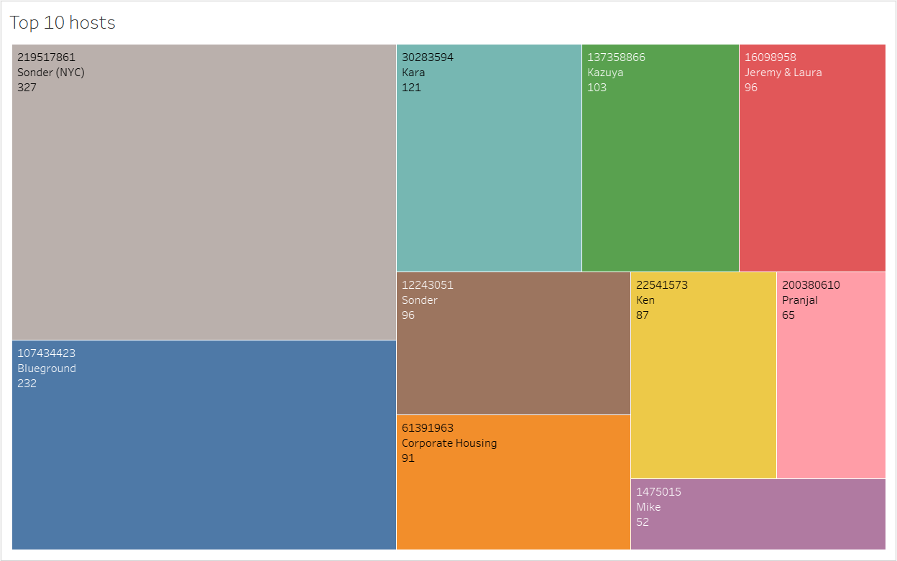
Top 10 Host
Host Sonder (id 219517861), has booked the greatest number of times i.e. 327.
Blueground is the second highest booking host.
Then there are the other hosts like Kara, Ken, Pranjal, Jeremy and Mike that fall under top 10 hosts.

Slide 6
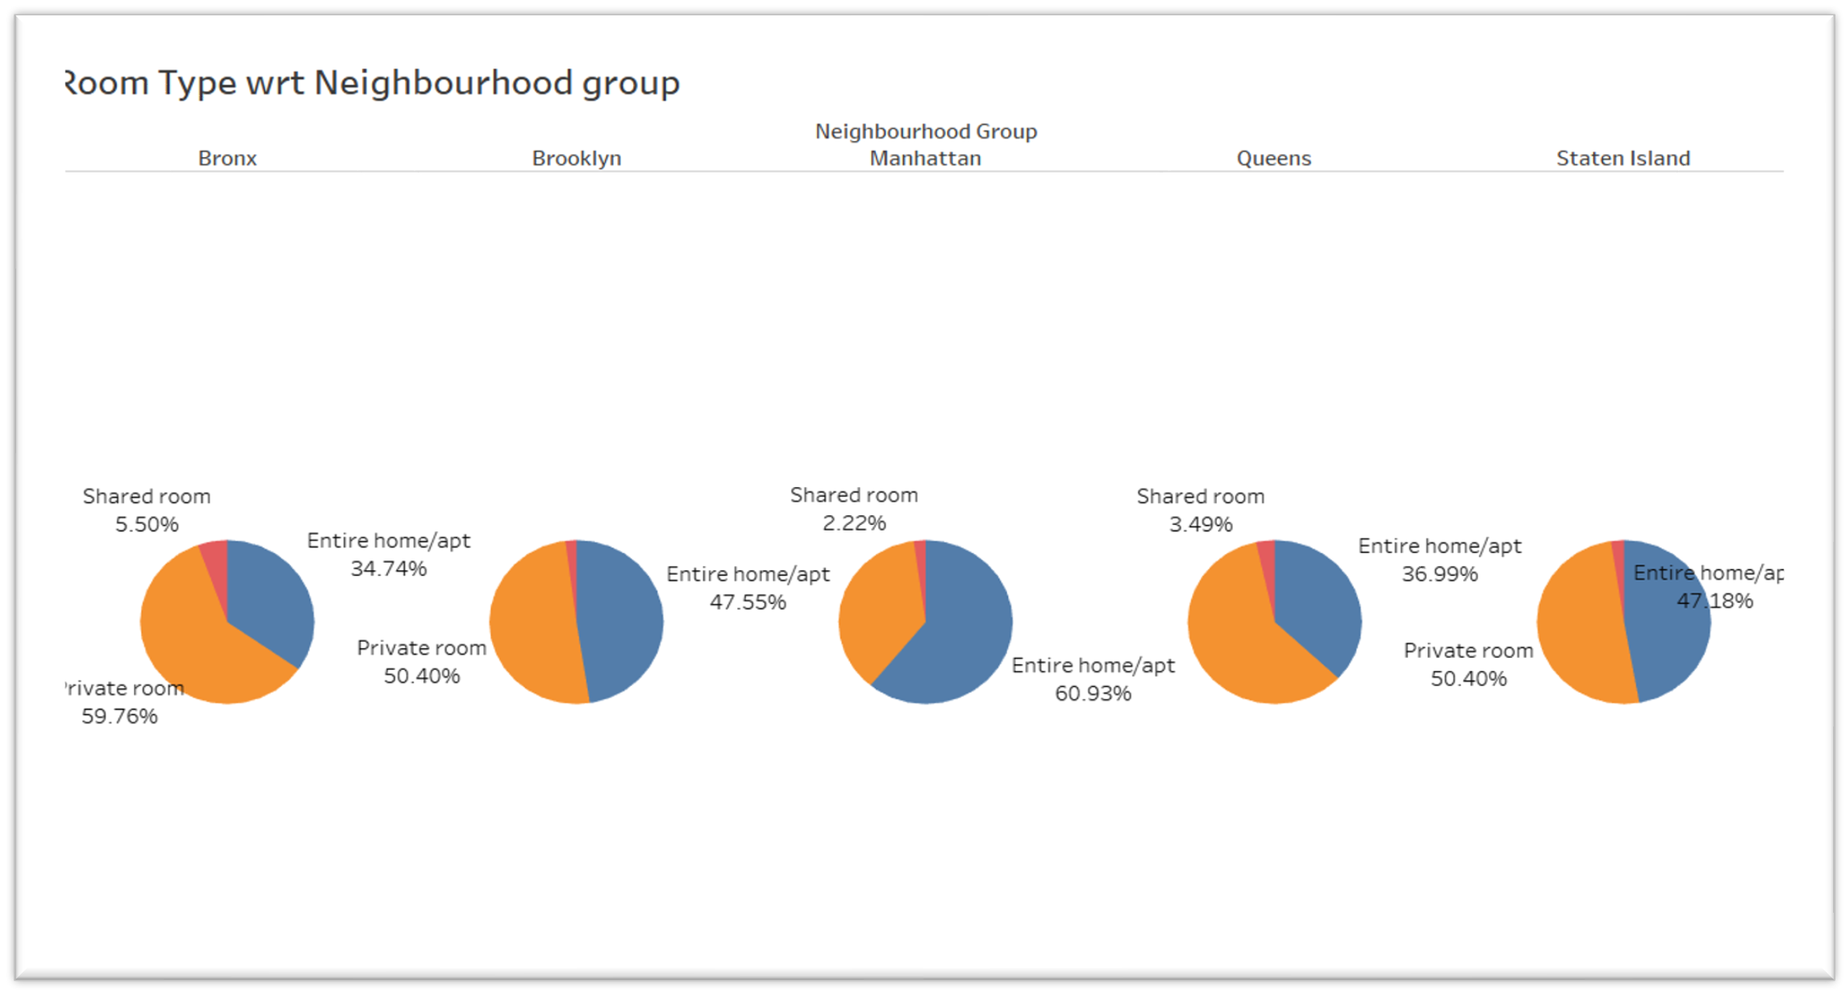
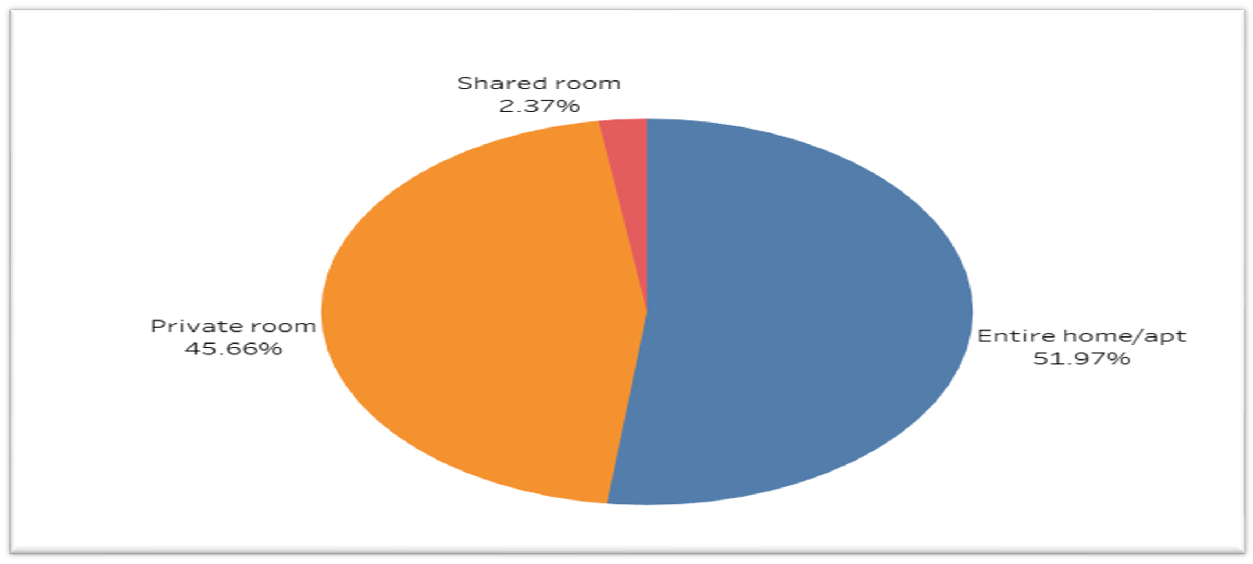
Room type with respect to Neighbourhood group
Three types of rooms are available - Entire home/Apartment, Private room & shared room.
Customers appear to prefer entire homes (52%), private rooms (45%) in comparison to shared rooms (2.4%).
Concentrating on promoting shared rooms with discounts to increase bookings and also acquire more private listings can help Airbnb to increase revene in Shared rooms.
Queens & Bronx contribute 60% each to private rooms, more than the combined ratio of 45% Whereas, Manhattan has a higher contribution in entire home (61%), compared to the combined ratio of 52%.

Slide 7
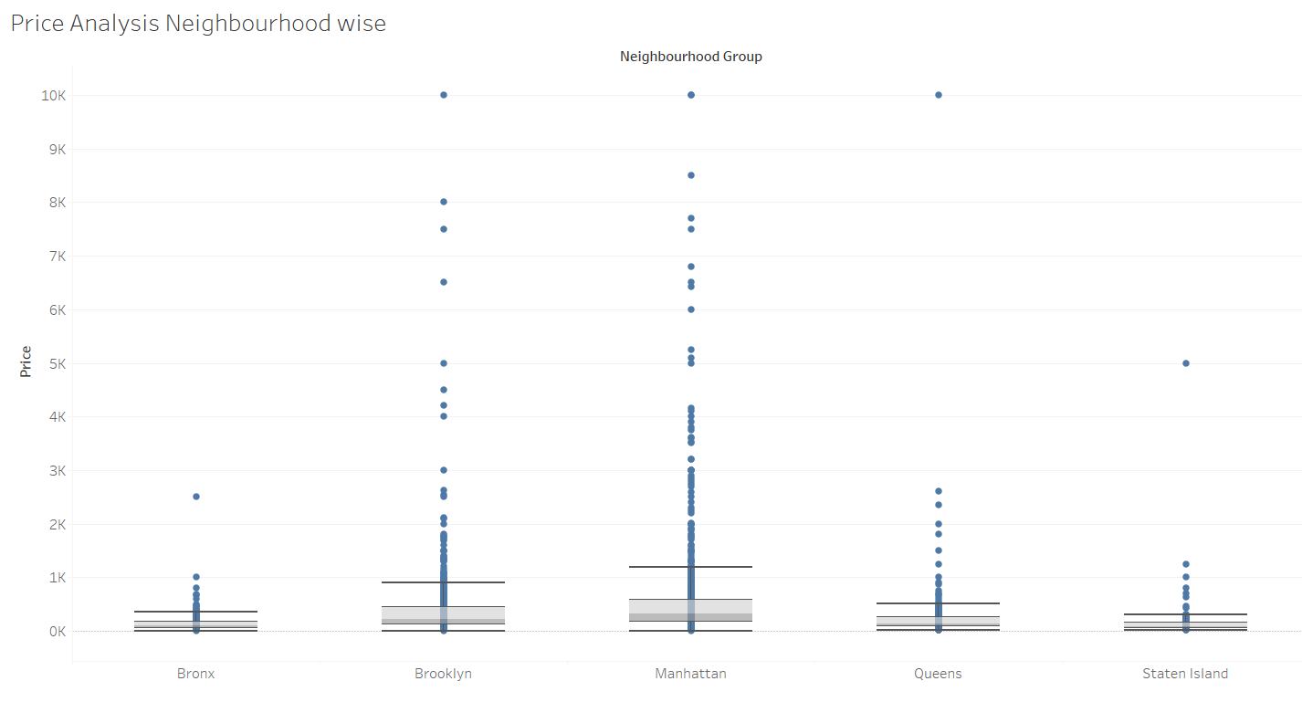
Price Analysis Neighbourhood wise
Manhattan has the highest range of prices for the listings.
Most of the outliers in Price column are for Brooklyn and Manhattan.
Bronx is the cheapest of them all.
We can see the median price of all
neighbourhood groups lying
between $ 80 to $ 300.
Price was highly positively skewed
so median was very close the lower quartile with some outliers as seen in the boxplot below.

Slide 8
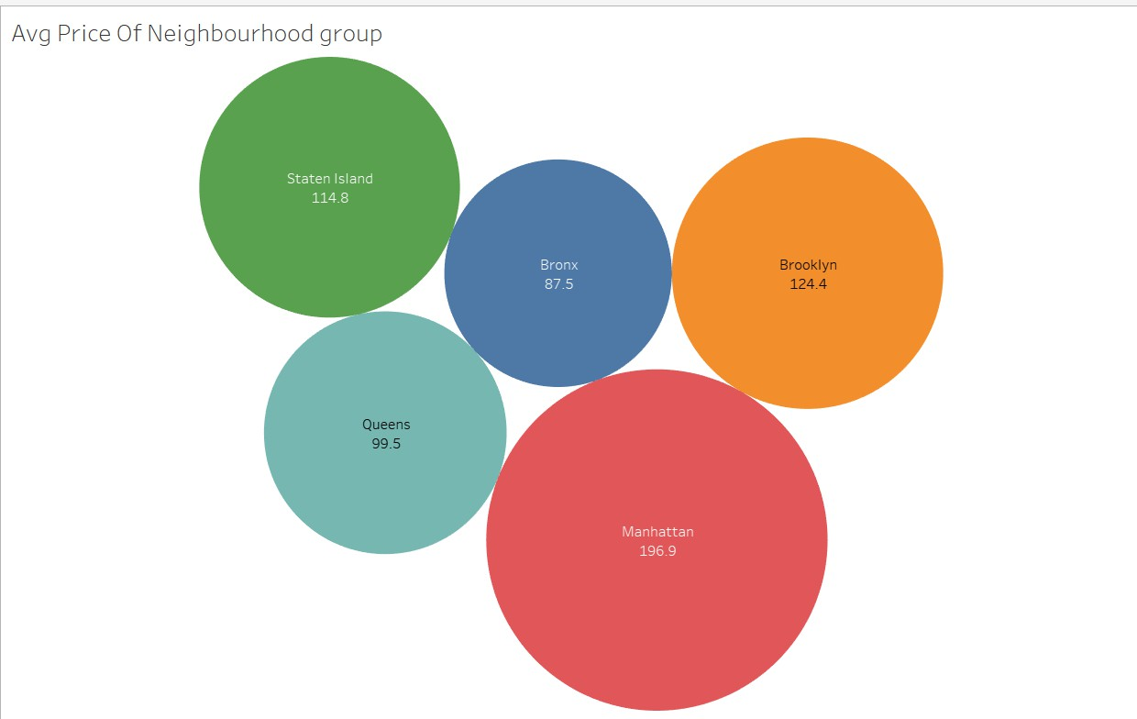

Average price of Neighbourhood groups
Highest among all neighbourhoods is the average price of listed properties in Manhattan which is around 196.9.
Brooklyn is second highest with Average price of 124.4.
Bronx appears to be an affordable neighbourhood as the average price is almost half than Manhattan’s average price.

Slide 9
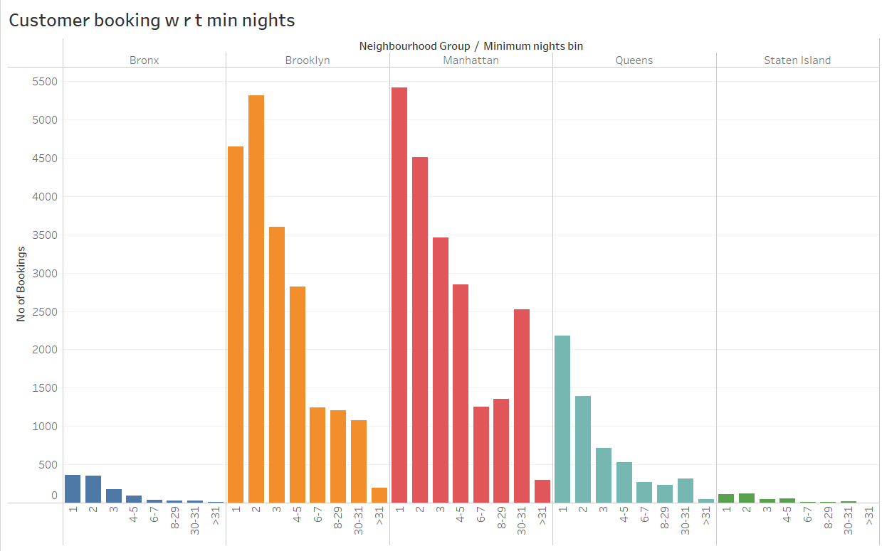
Customer Booking with respect to minimum nights
We can see a prominent spike in 30 days, this would be because customers would rent out on a monthly basis. The listings with Minimum nights 1-5 have the most number of bookings.
We can also see small spikes, this can also be explained by the monthly rent taking trend after 30 days.
Manhattan number
& Queens have higher of 30 day bookings
compared to the others. The reason could be either tourists booking long stays or mid-level employees who opt for budget bookings due company visits

Slide 10
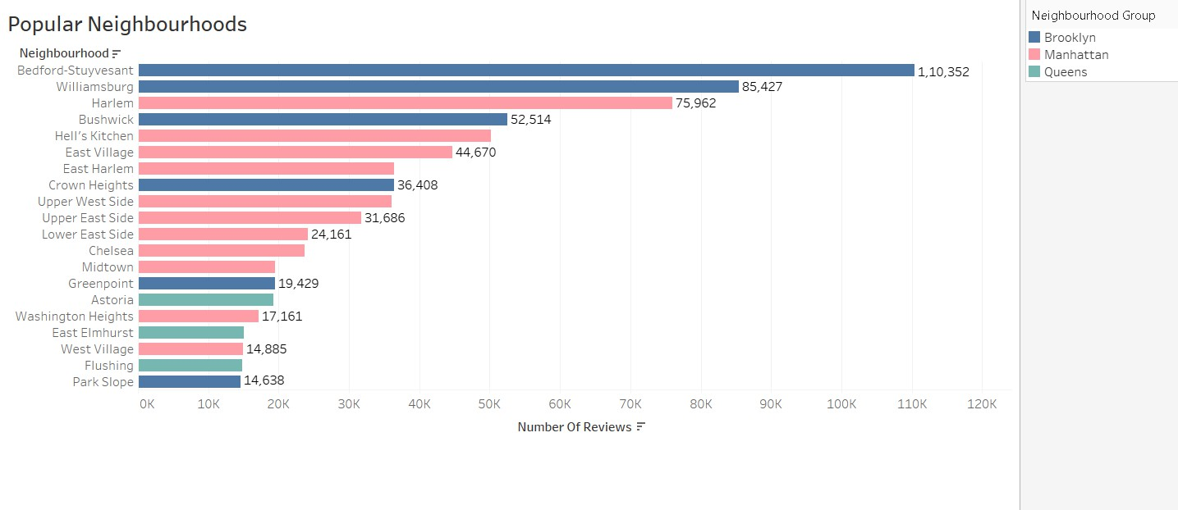
Popular Neighborhoods
Bedford-Stuyvesant from Brooklyn is the most popular with 1,10,352 no of reviews in total followed by Williamsburg.
Harlem from Manhattan got the highest no of reviews followed by Hell’s kitchen.
Higher satisfaction in these localities means higher number of customer reviews.

Slide 11
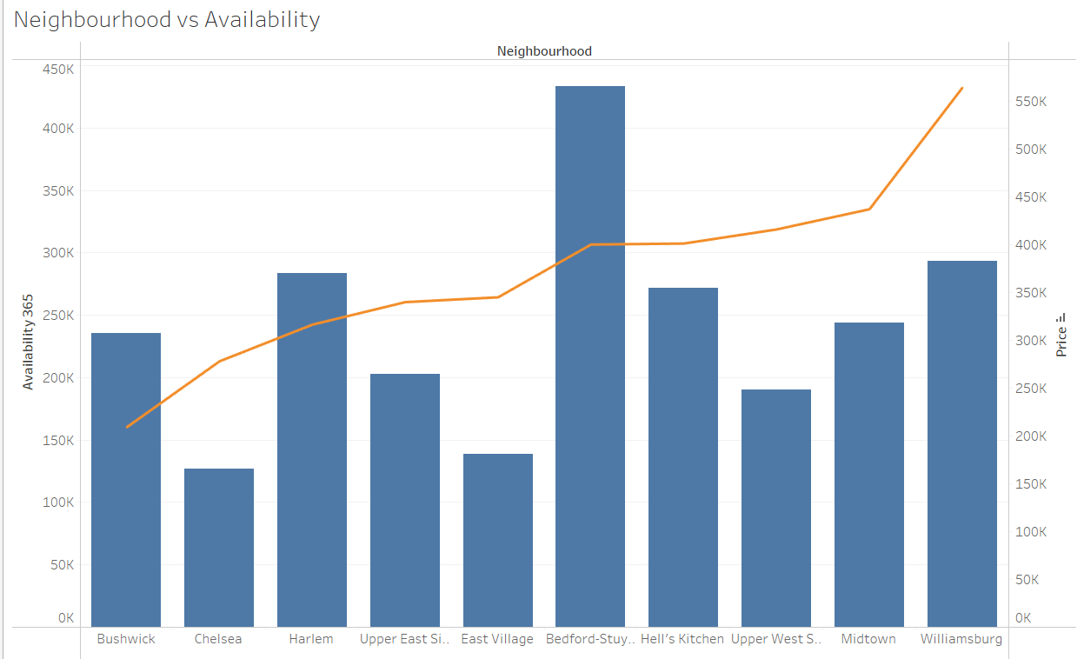
Neighbourhood vs Availability
Bedford availability is the highest and its price is on the lower side. It is a good choice for customers.
Harlem follows the same trend after Bedford.
Chelsea’s availability low but it is costly.
William’s price is high and has average availability.

